Slide 1
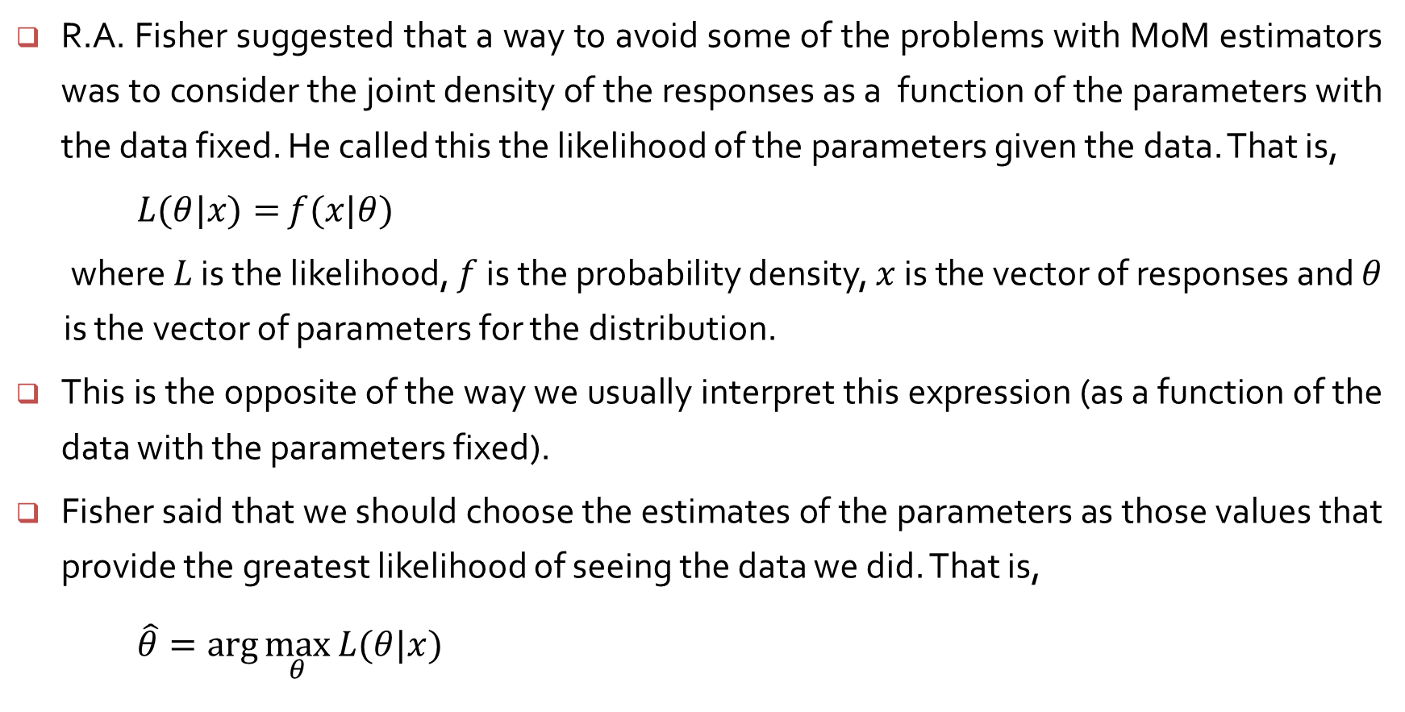
Maximum likelihood estimators
R.A. Fisher suggested that a way to avoid some of the problems with MoM estimators was to consider the joint density of the responses as a function of the parameters with the data fixed. He called this the likelihood of the parameters given the data. That is,
$L(θ|x)=$ $f(x|θ)$
where $L$ is the likelihood, $f$ is the probability density, $x$ is the vector of responses and $θ$ is the vector of parameters for the distribution.
This is the opposite of the way we usually interpret this expression (as a function of the data with the parameters fixed).
Fisher said that we should choose the estimates of the parameters as those values that provide the greatest likelihood of seeing the data we did. That is,
$\hat{θ}=\arg{\max_{θ}{L(θ|x)}}$

Slide 2
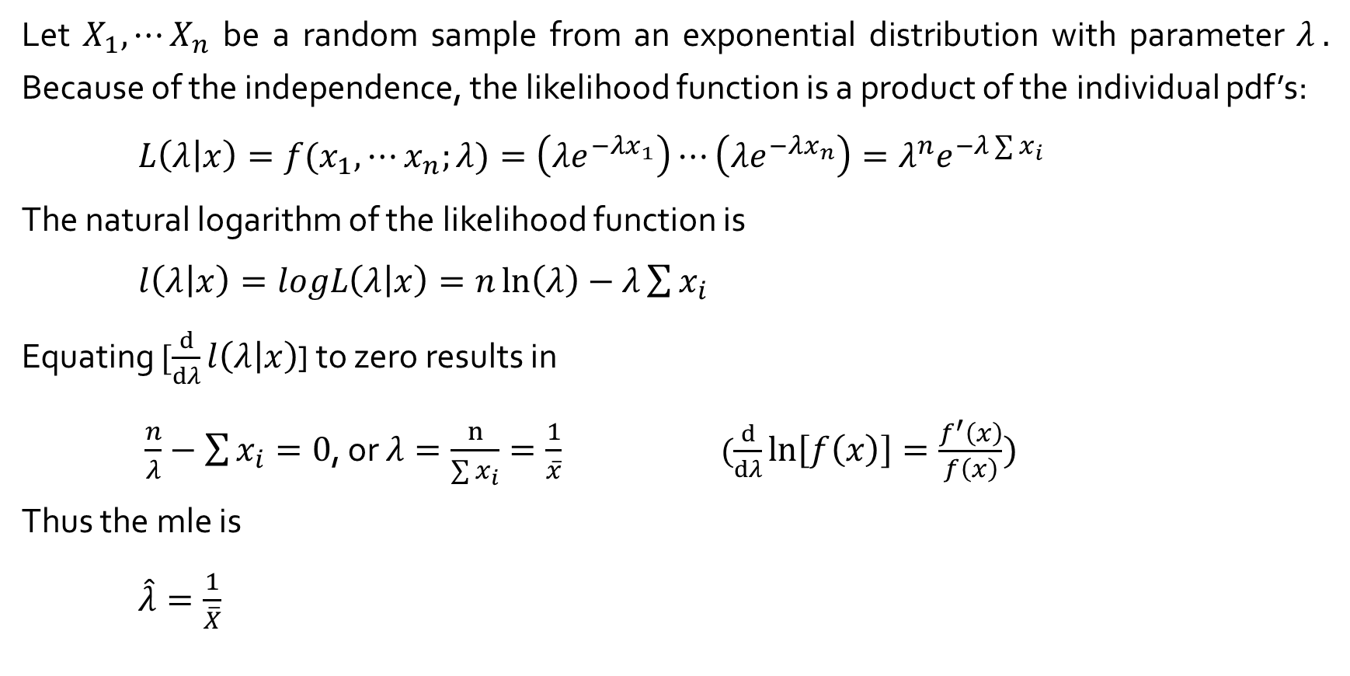
Maximum Likelihood Estimation – Example 6.16
Let $X_{1}, ⋯X_{n}$ be a random sample from an exponential distribution with parameter $λ .$ Because of the independence, the likelihood function is a product of the individual pdf’s:
${L\left(λ | x\right)=f(x}_{1}, ⋯x_{n};λ)=\left(λe^{−λx_{1}}\right)⋯\left(λe^{−λx_{n}}\right)=λ^{n}e^{−λ\sum{x_{i}}}$
The natural logarithm of the likelihood function is
$l\left(λ | x\right)=logL\left(λ | x\right)=n\ln\left(λ\right)−λ\sum{x_{i}}$
Equating $[\frac{d}{dλ}l\left(λ | x\right)$] to zero results in
$\frac{n}{λ}−\sum{x_{i}}=0$, or $λ=\frac{n}{\sum{x_{i}}}=\frac{1}{\overline{x}}$ $(\frac{d}{dλ}\ln\left[f\left(x\right)\right]=\frac{f^{′}\left(x\right)}{f\left(x\right)})$
Thus the mle is
$\hat{λ}=\frac{1}{\overline{X}}$

Slide 3

Example 6.11 gives data on breakdown voltages that are assumed to come from an exponential distribution.
41.53, 18.73, 2.99, 30.34, 12.33, 117.52, 73.02, 223.63, 4.00, 26.78
${L\left(λ | x\right)=f(x}_{1}, ⋯x_{n};λ)=\left(λe^{−λx_{1}}\right)⋯\left(λe^{−λx_{n}}\right)$
$=\left(λe^{−41.53λ}\right)⋯\left(λe^{−26.78λ}\right)=λ^{10}e^{−550.97λ}$

Slide 4
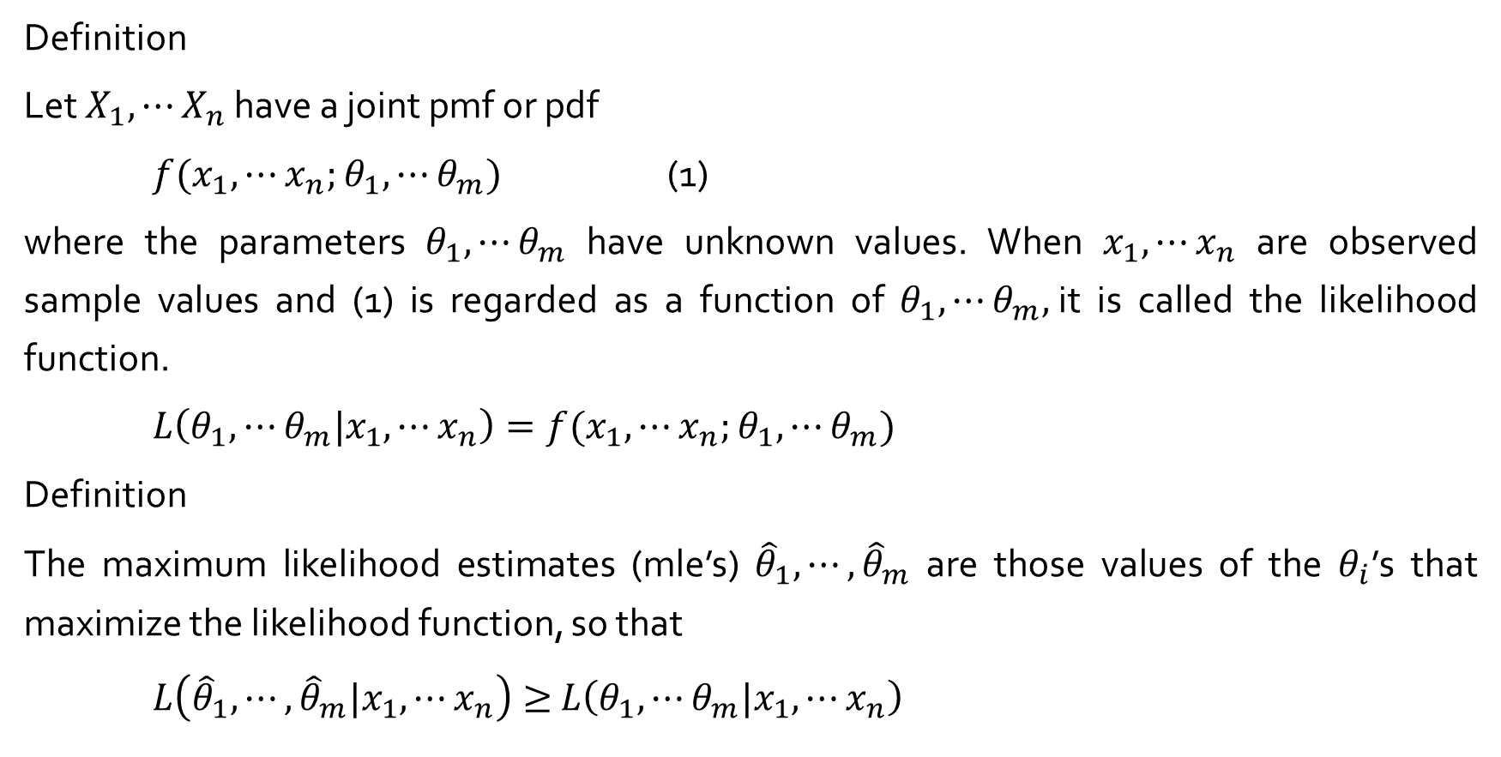
Maximum Likelihood Estimation
Definition
Let $X_{1}, ⋯X_{n}$ have a joint pmf or pdf
${f(x}_{1}, ⋯x_{n};$ $θ_{1}, ⋯θ_{m})$ (1)
where the parameters $θ_{1}, ⋯θ_{m}$ have unknown values. When $x_{1}, ⋯x_{n}$ are observed sample values and (1) is regarded as a function of $θ_{1}, ⋯θ_{m},$it is called the likelihood function.
${L\left(θ_{1}, ⋯θ_{m}|x_{1}, ⋯x_{n}\right)=f(x}_{1}, ⋯x_{n};$ $θ_{1}, ⋯θ_{m})$
Definition
The maximum likelihood estimates (mle’s) ${\hat{θ}}_{1}, ⋯,{\hat{θ}}_{m}$ are those values of the $θ_{i}$’s that maximize the likelihood function, so that
$L\left({\hat{θ}}_{1}, ⋯,{\hat{θ}}_{m}|x_{1}, ⋯x_{n}\right)≥$ $L\left(θ_{1}, ⋯θ_{m}|x_{1}, ⋯x_{n}\right)$

Slide 5
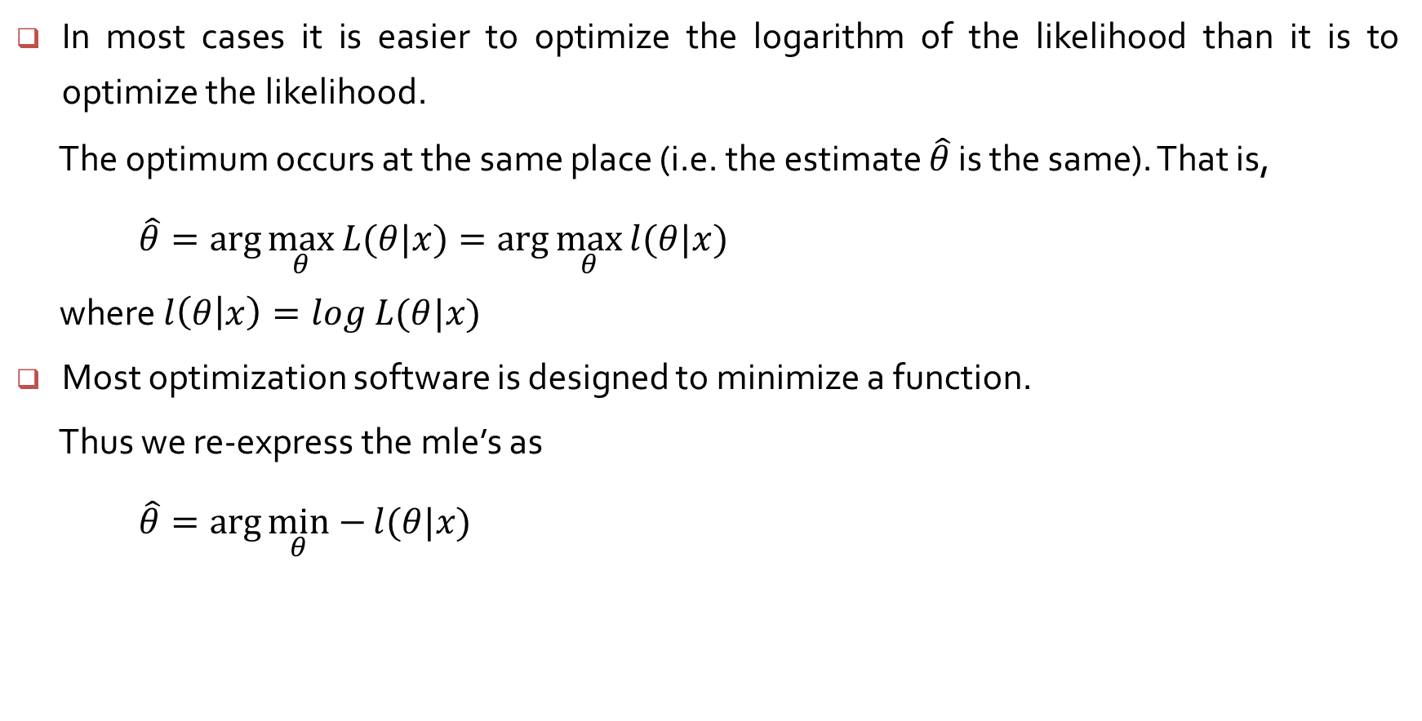
Maximum Likelihood Estimation in practice
In most cases it is easier to optimize the logarithm of the likelihood than it is to optimize the likelihood.
The optimum occurs at the same place (i.e. the estimate $\hat{θ}$ is the same). That is,
$\hat{θ}=\arg{\max_{θ}{L(θ|x)}}=\arg{\max_{θ}{l(θ|x)}}$
where $l\left(θ | x\right)=log$ $L(θ|x)$
Most optimization software is designed to minimize a function.
Thus we re-express the mle’s as
$\hat{θ}=\arg{\min_{θ}−{l(θ|x)}}$

Slide 6
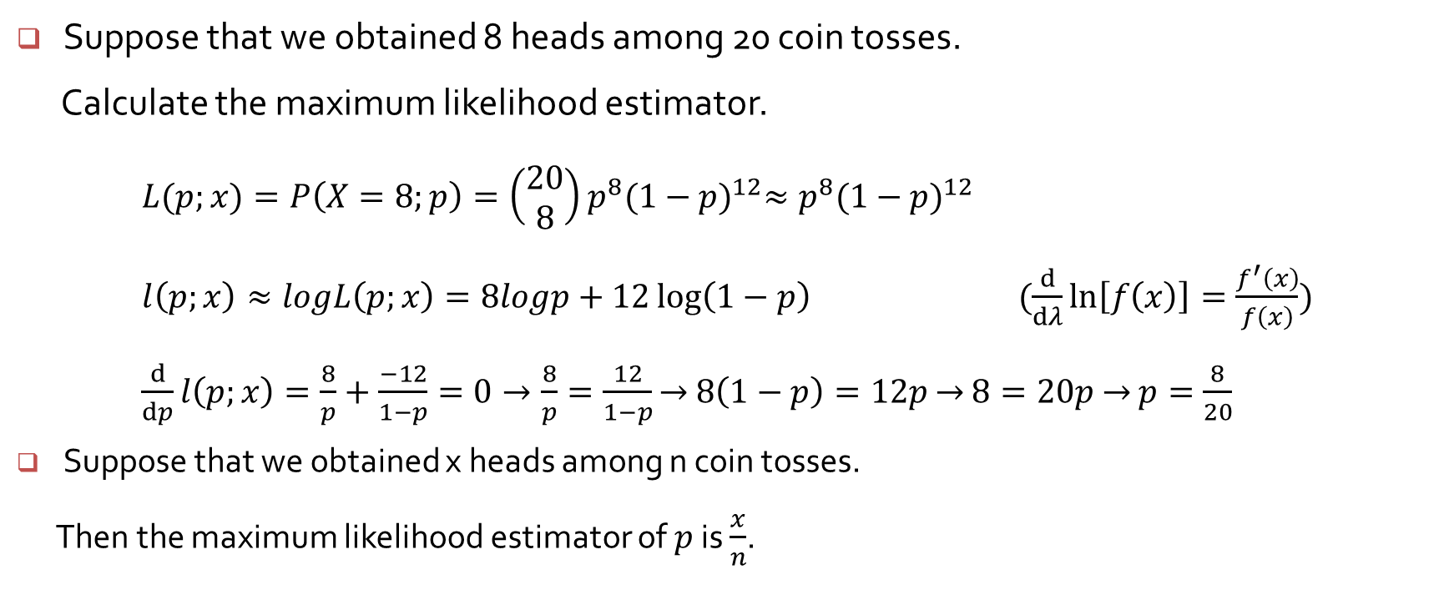
Maximum likelihood estimator example
Suppose that we obtained 8 heads among 20 coin tosses.
Calculate the maximum likelihood estimator.
$L(p;x)=P\left(X=8;p\right)=\left(\begin{matrix}20 \\ 8\end{matrix}\right)p^{8}{(1−p)}^{12}≈p^{8}{(1−p)}^{12}$
$l\left(p;x\right)≈logL\left(p;x\right)=8logp+12\log\left(1−p\right)$ $(\frac{d}{dλ}\ln\left[f\left(x\right)\right]=\frac{f^{′}\left(x\right)}{f\left(x\right)})$
$\frac{d}{dp}l\left(p;x\right)=\frac{8}{p}+\frac{−12}{1−p}=0→\frac{8}{p}=\frac{12}{1−p}$ $→$ $8\left(1−p\right)=12p$ $→$ $8=20p$ $→$ $p=\frac{8}{20}$
Suppose that we obtained x heads among n coin tosses.
Then the maximum likelihood estimator of $p$ is $\frac{x}{n}$.

